Slide 1
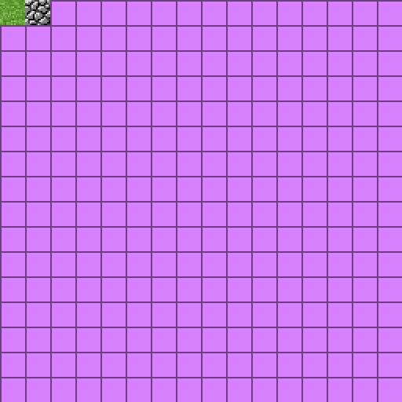

Slide 2
#version 330 core
layout (location = 0) in vec3 aPos;
layout(location = 1) in vec2 aTexCoord;
out vec2 TexCoord;
void main() {
gl_Position = vec4(aPos, 1.0);
TexCoord = aTexCoord;
}

Slide 3
#version 330 core
out vec4 FragColor;
uniform bool isWireframe;
in vec2 TexCoord;
uniform sampler2D texture0;
void main() {
if(isWireframe) {
FragColor = vec4(0.0f);
}
else {
FragColor = texture(texture0, TexCoord);
}
}

Slide 4
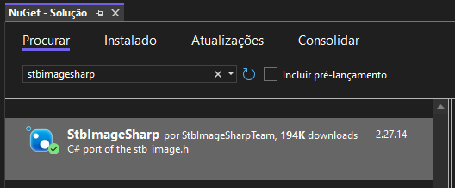

Slide 5
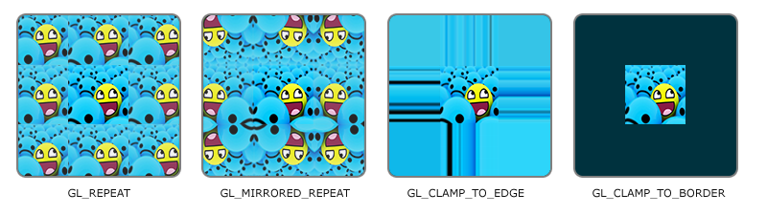

Slide 6
GL.TexParameter(TextureTarget.Texture2D, TextureParameterName.TextureWrapS, (int)TextureWrapMode.Repeat);
GL.TexParameter(TextureTarget.Texture2D, TextureParameterName.TextureWrapT, (int)TextureWrapMode.Repeat);

Slide 7


Slide 8
GL.TexParameter(TextureTarget.Texture2D, TextureParameterName.TextureMinFilter, (int)TextureMinFilter.Nearest);
GL.TexParameter(TextureTarget.Texture2D, TextureParameterName.TextureMagFilter, (int)TextureMagFilter.Nearest);

Slide 9
using OpenTK.Graphics.OpenGL4;
using StbImageSharp;
public class Texture() {
public int texture;
public Texture(string texturePath) {
GL.GenTextures(1, out texture);
GL.BindTexture(TextureTarget.Texture2D, texture);
GL.TexParameter(TextureTarget.Texture2D, TextureParameterName.TextureWrapS, (int)TextureWrapMode.Repeat);
GL.TexParameter(TextureTarget.Texture2D, TextureParameterName.TextureWrapT, (int)TextureWrapMode.Repeat);
GL.TexParameter(TextureTarget.Texture2D, TextureParameterName.TextureMinFilter, (int)TextureMinFilter.Nearest);
GL.TexParameter(TextureTarget.Texture2D, TextureParameterName.TextureMagFilter, (int)TextureMagFilter.Nearest);
//StbImage.stbi_set_flip_vertically_on_load(1);
ImageResult image = ImageResult.FromStream(File.OpenRead("../../../src/textures/" + texturePath), ColorComponents.RedGreenBlueAlpha);
if(image.Data != null) {
GL.TexImage2D(TextureTarget.Texture2D, 0, PixelInternalFormat.Rgba, image.Width, image.Height, 0, PixelFormat.Rgba, PixelType.UnsignedByte, image.Data);
GL.GenerateMipmap(GenerateMipmapTarget.Texture2D);
}
else {
Console.WriteLine("Failed to load texture");
}
}
public void bind() {
GL.BindTexture(TextureTarget.Texture2D, texture);
}
}

Slide 10
using OpenTK.Graphics.OpenGL4;
using OpenTK.Windowing.Common;
using OpenTK.Windowing.Desktop;
using OpenTK.Windowing.GraphicsLibraryFramework;
namespace SeuNamespaceAqui; public class Program : GameWindow {
[...]
private Texture texture;
[...]
protected override void OnLoad() {
[...]
texture = new Texture();
}
protected override void OnRenderFrame(FrameEventArgs args) {
[...]
texture.bind();
}
[...]
}

Slide 11
+V
0.0f, 1.0f
3
2
1.0f, 1.0f
0.0f, 0.0f
1.0f, 0.0f
1.0f, 1.0f
0.0f, 1.0f
0.0f, 0.0f
0
1
1.0f, 0.0f
+U

Slide 12
private float[] vertexBuffer = new float[300000];
private int vertices = 0;
private Tesselator() {
float x0 = -0.5f;
float x1 = 0.5f;
float y0 = -0.5f;
float y1 = 0.5f;
this.vertex(x0, y0); // bottom left
this.vertex(x1, y0); // bottom right
this.vertex(x1, y1); // top right
this.vertex(x0, y1); // top left
[...]
}
[...]
private void vertex(int x, int y) {
vertexBuffer[vertices * 2 + 0] = x;
vertexBuffer[vertices * 2 + 1] = y;
vertices++;
}

Slide 13
private float[] texCoordBuffer = new float[200000];
private int TBO; // Texture Buffer Object
public void flush() {
[...]
GL.GenBuffers(1, out this.TBO);
GL.BindBuffer(BufferTarget.ArrayBuffer, this.TBO);
GL.BufferData(BufferTarget.ArrayBuffer, this.texCoordBuffer.Length * sizeof(float), this.texCoordBuffer, BufferUsageHint.StaticDraw);
GL.VertexAttribPointer(1, 2, VertexAttribPointerType.Float, false, 0, 0);
GL.EnableVertexAttribArray(1);
[...]
}
private void tex(float u, float v) {
this.texCoordBuffer[this.vertices * 2 + 0] = u;
this.texCoordBuffer[this.vertices * 2 + 1] = v;
}

Slide 14
private float[] vertexBuffer = new float[300000];
private int vertices = 0;
private Tesselator() {
float x0 = -0.5f;
float x1 = 0.5f;
float y0 = -0.5f;
float y1 = 0.5f;
float u0 = 0.0f;
float v0 = 0.0f;
float u1 = 1.0f;
float v1 = 1.0f;
this.tex(u0, v0);
this.vertex(x0, y0); // bottom left
this.tex(u1, v0);
this.vertex(x1, y0); // bottom right
this.tex(u1, v1);
this.vertex(x1, y1); // top right
this.tex(u0, v1);
this.vertex(x0, y1); // top left
[...]
}
[...]
private void vertex(int x, int y) {
[...]
}
public void tex(float u, float v) {
[...]
}

Slide 15
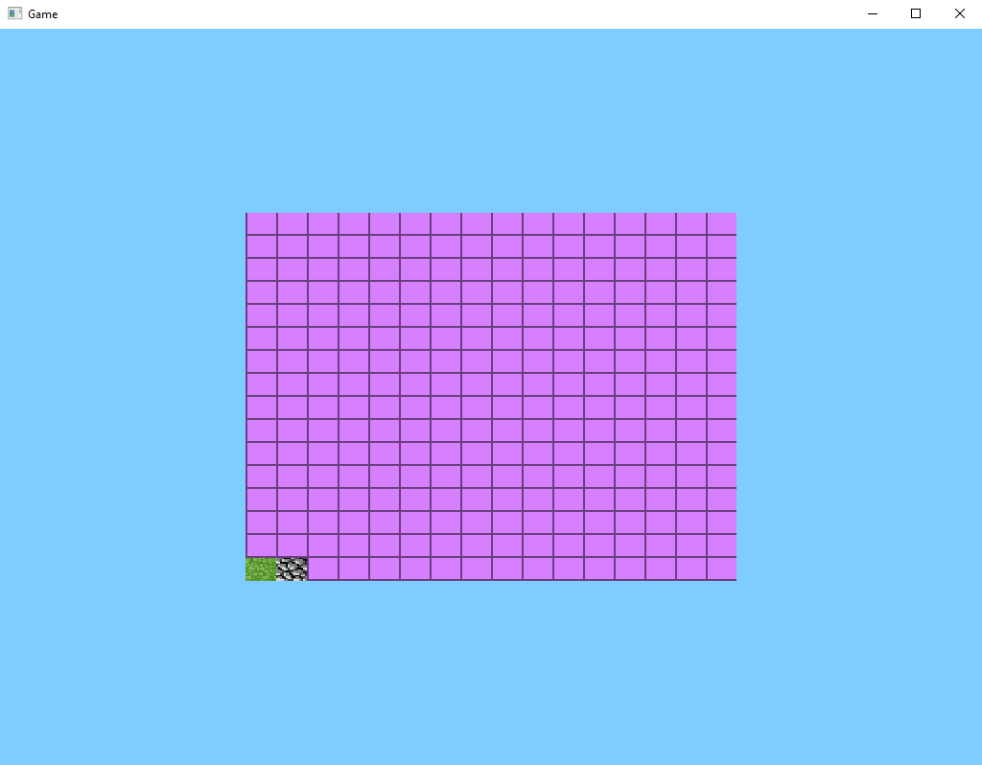

Slide 16
Então acrescentamos essa linha..
StbImage.stbi_set_flip_vertically_on_load(1);

Slide 17
using OpenTK.Graphics.OpenGL4;
using StbImageSharp;
public class Texture() {
public int texture;
public Texture(string texturePath) {
GL.GenTextures(1, out texture);
GL.BindTexture(TextureTarget.Texture2D, texture);
GL_TEXTURE_2D agora terão efeito neste objeto de textura
GL.TexParameter(TextureTarget.Texture2D, TextureParameterName.TextureWrapS, (int)TextureWrapMode.Repeat);
GL.TexParameter(TextureTarget.Texture2D, TextureParameterName.TextureWrapT, (int)TextureWrapMode.Repeat);
GL.TexParameter(TextureTarget.Texture2D, TextureParameterName.TextureMinFilter, (int)TextureMinFilter.Nearest);
GL.TexParameter(TextureTarget.Texture2D, TextureParameterName.TextureMagFilter, (int)TextureMagFilter.Nearest);
StbImage.stbi_set_flip_vertically_on_load(1);
ImageResult image = ImageResult.FromStream(File.OpenRead("../../../src/textures/" + texturePath), ColorComponents.RedGreenBlueAlpha);
if(image.Data != null) {
GL.TexImage2D(TextureTarget.Texture2D, 0, PixelInternalFormat.Rgba, image.Width, image.Height, 0, PixelFormat.Rgba, PixelType.UnsignedByte, image.Data);
GL.GenerateMipmap(GenerateMipmapTarget.Texture2D);
}
else {
Console.WriteLine("Failed to load texture");
}
}
public void bind() {
GL.BindTexture(TextureTarget.Texture2D, texture);
}
}

Slide 18
+V
0.0f, 1.0f
3
2
1.0f, 1.0f
0.0f, 0.0f
1.0f, 0.0f
1.0f, 1.0f
0.0f, 1.0f
0.0f, 0.0f
0
1
1.0f, 0.0f
+U

Slide 19
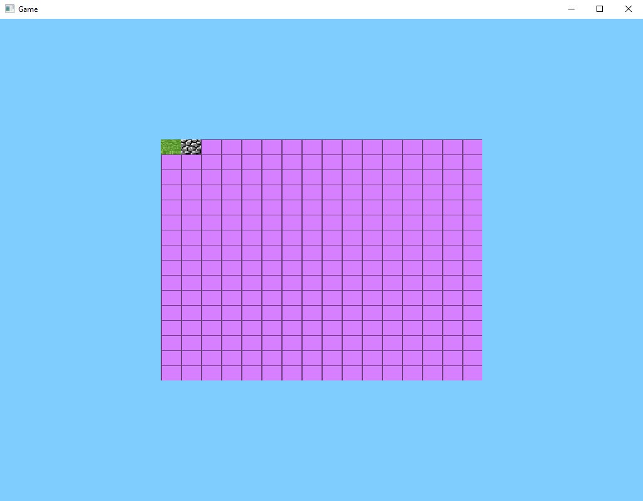

Slide 20
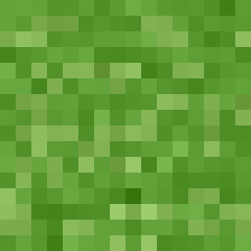

Slide 21
+V
1.0f
0.5f
0.0f
+U

Slide 22
+V
1.0f
0.75f
0.5f
0.25f
0.0f
+U

Slide 23
+V
1.0f
0.9375f
0.875f
0.8125f
0.75f
0.6875f
0.625f
0.5625f
0.5f
0.4375f
0.375f
0.3125f
0.25f
0.1875f
0.125f
0.0625f
0.0f
+U

Slide 24
+V
0.0f, 1.0f
0.0625f, 1.0f
3
2
0
1
0.0f, 0.9375f
0.0625f, 0.9375f
0.0f, 0.9375f
0.0625f, 0.9375f
0.0625f, 1.0f
0.0f, 1.0f
+U

Slide 25
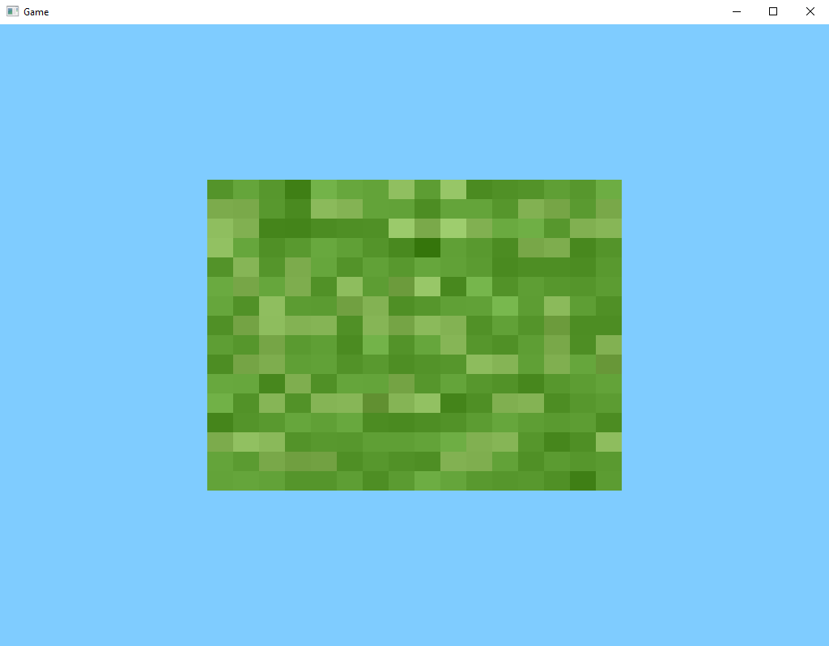

Slide 26

NOTA: Ele pega as texturas de baixo para cima
+V
+V
u0, v1
x1, v1
3
2
int tex = 0;
float u0 = (float)tex / 16.0f;
float v0 = 0.0f;
float u1 = u0 + (1.0f / 16.0f);
float v1 = v0 + (1.0f / 16.0f);
+U
0
1
x0, v0
x1, v0
u0, v0
u1, v0
u1, v1
u0, v1
u0, v1
u1, v1
3
2
+U
0
1
u0, v0
u1, v0

Slide 27
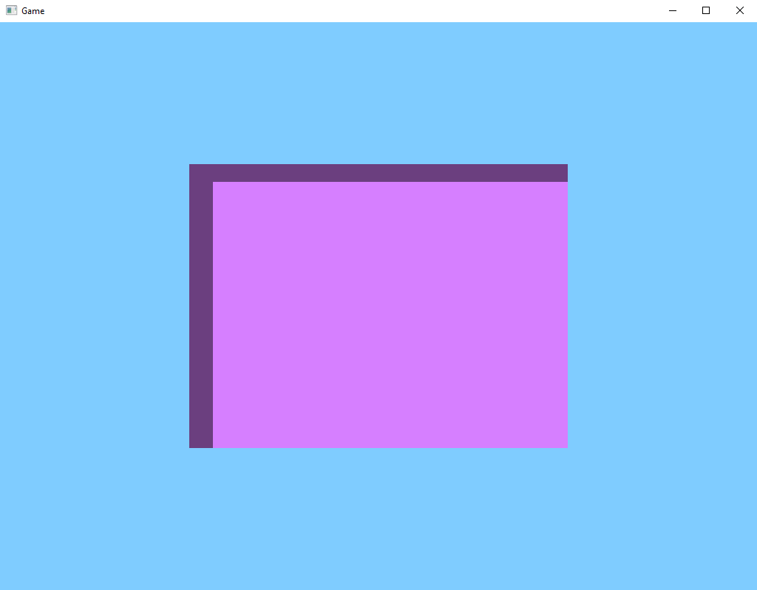

Slide 28
Se removermos essa linha, meio que da certo...
//StbImage.stbi_set_flip_vertically_on_load(1);

Slide 29
NOTA: A textura ficara de ponta cabeça
+V
Textura Correta
+V
u0, v1
x1, v1
int tex = 0;
float u0 = (float)tex / 16.0f;
float v0 = 0.0f;
float u1 = u0 + (1.0f / 16.0f);
float v1 = v0 + (1.0f / 16.0f);
Textura Invertida
3
2
+U
0
1
x0, v0
x1, v0
u0, v0
u1, v0
u1, v1
u0, v1
u0, v1
u1, v1
3
2
+U
0
1
u0, v0
u1, v0

Slide 31
Uma maneira de corrigir é modificando os pontos de coordenadas
+V
+V
u0, v1
x1, v1
0
1
int tex = 0;
float u0 = (float)tex / 16.0f;
float v0 = 0.0f;
float u1 = u0 + (1.0f / 16.0f);
float v1 = v0 + (1.0f / 16.0f);
+U
3
2
x0, v0
x1, v0
u0, v1
u1, v1
u1, v0
u0, v0
u0, v1
u1, v1
0
1
+U
3
2
u0, v0
u1, v0

Slide 32
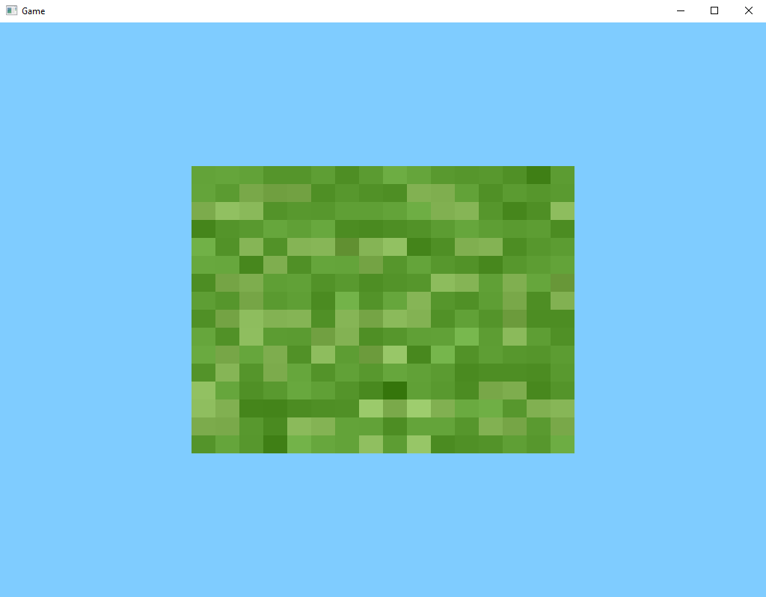

Slide 33
Outra maneira de corrigir é mantendo essa linha...
StbImage.stbi_set_flip_vertically_on_load(1);

Slide 34
Ele ainda vai pegar as texturas de baixo para cima
+V
+V
u0, v1
x1, v1
3
2
int tex = 0;
float u0 = (float)tex / 16.0f;
float v0 = 0.0f;
float u1 = u0 + (1.0f / 16.0f);
float v1 = v0 + (1.0f / 16.0f);
+U
0
1
x0, v0
x1, v0
u0, v0
u1, v0
u1, v1
u0, v1
u0, v1
u1, v1
3
2
+U
0
1
u0, v0
u1, v0

Slide 35
Então dizendo para ‘v0’ ler de cima para baixo
+V
u0, v1
u1, v1
3
2
0
1
u0, v0
u1, v0
+V
u0, v1
x1, v1
3
2
int tex = 0;
float u0 = (float)tex / 16.0f;
float v0 = (16.0f – 1.0f) / 16.0f;
float u1 = u0 + (1.0f / 16.0f);
float v1 = v0 + (1.0f / 16.0f);
+U
0
1
x0, v0
x1, v0
u0, v0
u1, v0
u1, v1
u0, v1
+U

Slide 36
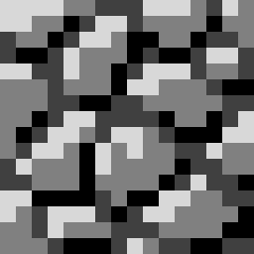
Quando ‘tex’ for igual a 1, teremos a textura da pedra...
+V
u0, v1
u1, v1
3
2
0
1
u0, v0
u1, v0
+V
u0, v1
x1, v1
3
2
int tex = 1;
float u0 = (float)tex / 16.0f;
float v0 = (16.0f – 1.0f) / 16.0f;
float u1 = u0 + (1.0f / 16.0f);
float v1 = v0 + (1.0f / 16.0f);
+U
0
1
x0, v0
x1, v0
u0, v0
u1, v0
u1, v1
u0, v1
+U

Slide 37
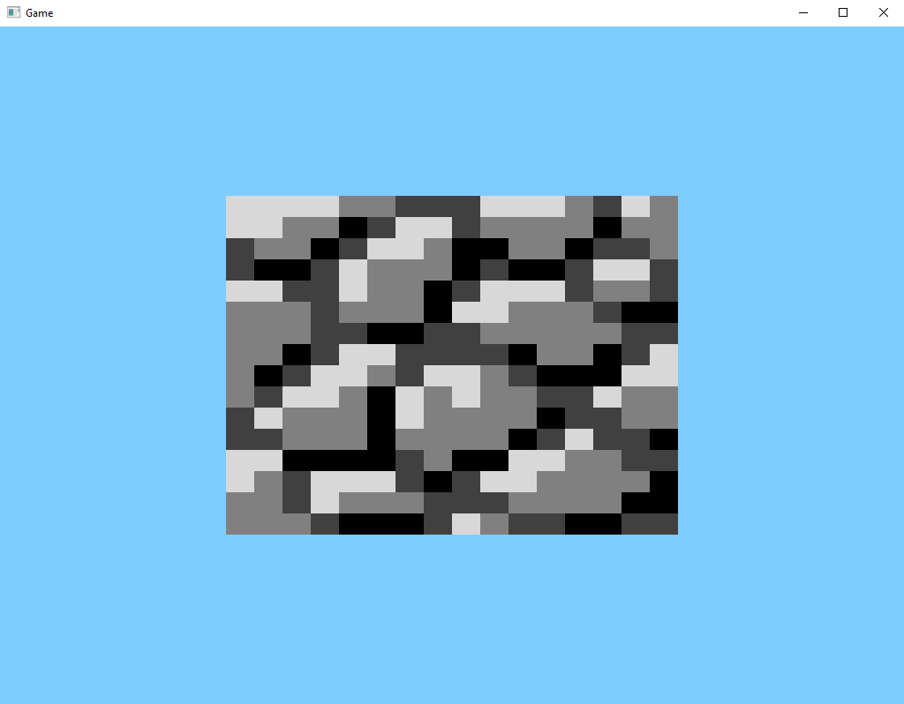

Slide 38
Quando ‘tex’ for igual a 15, teremos a textura do canto superior direito...
+V
u0, v1
u1, v1
3
2
0
1
u0, v0
u1, v0
+V
u0, v1
x1, v1
3
2
int tex = 15;
float u0 = (float)tex / 16.0f;
float v0 = (16.0f – 1.0f) / 16.0f;
float u1 = u0 + (1.0f / 16.0f);
float v1 = v0 + (1.0f / 16.0f);
+U
0
1
x0, v0
x1, v0
u0, v0
u1, v0
u1, v1
u0, v1
+U

Slide 39
Mas quando ‘tex’ for igual a 16, teremos novamente a textura da grama...
+V
u0, v1
u1, v1
3
2
0
1
u0, v0
u1, v0
+V
u0, v1
x1, v1
3
2
int tex = 16;
float u0 = (float)tex / 16.0f;
float v0 = (16.0f – 1.0f) / 16.0f;
float u1 = u0 + (1.0f / 16.0f);
float v1 = v0 + (1.0f / 16.0f);
+U
0
1
x0, v0
x1, v0
u0, v0
u1, v0
u1, v1
u0, v1
+U

Slide 40
tex % 16
tex = 0, retorna 0
tex = 1, retorna 1
tex = 2, retorna 2
tex = 3, retorna 3
tex = 4, retorna 4
tex = 5, retorna 5
tex = 6, retorna 6
tex = 7, retorna 7
tex = 8, retorna 8
tex = 9, retorna 9
tex = 10, retorna 10
tex = 11, retorna 11
tex = 12, retorna 12
tex = 13, retorna 13
tex = 14, retorna 14
tex = 15, retorna 15
tex = 16, retorna 0
tex = 17, retorna 1
tex = 18, retorna 2
tex = 19, retorna 3
tex = 20, retorna 4
tex = 21, retorna 5
tex = 22, retorna 6
tex = 23, retorna 7
tex = 24, retorna 8
tex = 25, retorna 9
tex = 26, retorna 10
tex = 27, retorna 11
tex = 28, retorna 12
tex = 29, retorna 13
tex = 30, retorna 14
tex = 31, retorna 15
tex = 32, retorna 0
tex / 16
tex = 0, retorna 0
tex = 1, retorna 0
tex = 2, retorna 0
tex = 3, retorna 0
tex = 4, retorna 0
tex = 5, retorna 0
tex = 6, retorna 0
tex = 7, retorna 0
tex = 8, retorna 0
tex = 9, retorna 0
tex = 10, retorna 0
tex = 11, retorna 0
tex = 12, retorna 0
tex = 13, retorna 0
tex = 14, retorna 0
tex = 15, retorna 0
tex = 16, retorna 1
tex = 17, retorna 1
tex = 18, retorna 1
tex = 19, retorna 1
tex = 20, retorna 1
tex = 21, retorna 1
tex = 22, retorna 1
tex = 23, retorna 1
tex = 24, retorna 1
tex = 25, retorna 1
tex = 26, retorna 1
tex = 27, retorna 1
tex = 28, retorna 1
tex = 29, retorna 1
tex = 30, retorna 1
tex = 31, retorna 1
tex = 32, retorna 2

Slide 41
Uma das formas de corrigir isto...
+V
u0, v1
u1, v1
3
2
0
1
u0, v0
u1, v0
+V
u0, v1
x1, v1
3
2
int tex = 16;
float u0 = (float)(tex % 16) / 16.0f;
float v0 = ( (16.0f - 1.0f) – (float)(tex / 16) ) / 16.0f;
float u1 = u0 + (1.0f / 16.0f);
float v1 = v0 + (1.0f / 16.0f);
+U
0
1
x0, v0
x1, v0
u0, v0
u1, v0
u1, v1
u0, v1
+U

Slide 42
Ou dessa forma onde você da o numero da linha e da coluna da textura
+V
u0, v1
u1, v1
3
2
0
1
u0, v0
u1, v0
+V
u0, v1
x1, v1
3
2
int texU = 0;
int texV = 1;
float u0 = (float)tex / 16.0f;
float v0 = ((16.0f - 1.0f) - (float)texV) / 16.0f;
float u1 = u0 + (1.0f / 16.0f);
float v1 = v0 + (1.0f / 16.0f);
+U
0
1
x0, v0
x1, v0
u0, v0
u1, v0
u1, v1
u0, v1
+U

Slide 43
Mas não vamos nos preocupar com isso agora

Slide 44
Este é o resultado que queremos obter

Slide 46
+V
2
3
0.0f, 1.0f
1.0f, 1.0f
0.0f, 0.0f
1.0f, 0.0f
1.0f, 1.0f
0.0f, 1.0f
1
0
0.0f, 0.0f
1.0f, 0.0f
+U

